Slide 1

List, Tuple, Slicing
Trying to remember, I missed-out on buying the eggs; I better list 'em down the next time!
Prathmesh Palande
Pratik Loya
TOC EUS Automation
May 14, 2019

Slide 2
Section 1
Strings, Lists, Tuples, & Slicing

Slide 3
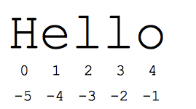

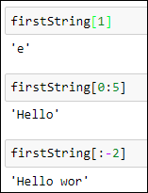
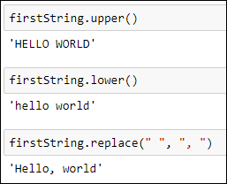
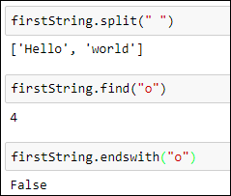
Strings
String – immutable and ordered sequence of characters
Sample Methods:
count
index
capitalize
split
endswith
find
replace
islower
isupper
lower
upper
lstrip
rstrip
strip

Slide 4


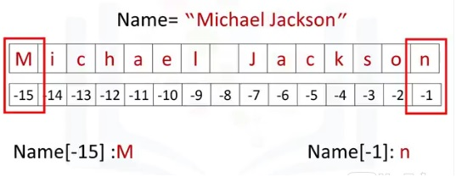
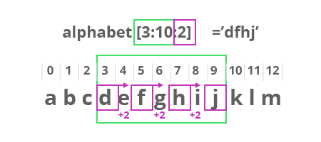
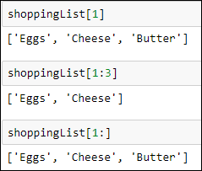
Lists
- ordered and mutable(changeable) collection of items
- Allows duplicate members.
Create a list:
Accessing/Slicing items:

Slide 5
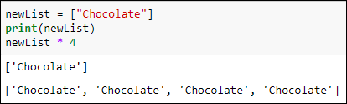


List Operations
Methods:
index
count
append
extend
insert
remove
pop
clear
sort
copy
Operators:
+
*

Slide 6
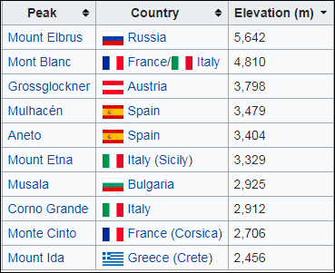


Tuples
Tuple – ordered and immutable collection of items
Accessing elements
Methods*:
count
index
*Operations which cause potential changes to a tuple are not permissible; reinforce the idea of immutability

Slide 7
Expressions / Math Operations
expression: A data value or set of operations to compute a value.
Examples: 1 + 4 * 3
42
Arithmetic operators we will use:
+ - * / addition, subtraction/negation, multiplication, division
% modulus, a.k.a. remainder
** exponentiation
precedence: Order in which operations are computed.
* / % ** have a higher precedence than + - 1 + 3 * 4 is 13
Parentheses can be used to force a certain order of evaluation. (1 + 3) * 4 is 16

Slide 8
Expressions Continued…
When we divide integers with / , the quotient is also an integer.
3 52
4 ) 14 27 ) 1425
12 135
2 75
54
21
More examples:
35 / 5 is 7
84 / 10 is 8
156 / 100 is 1
The % operator computes the remainder from a division of integers.
3 43
4 ) 14 5 ) 218
12 20
2 18
15
3
Syntax
Output
Code

Slide 9
Good to know Math Functions
Python has useful commands for performing calculations.
To use many of these commands, you must write the following at the top of your Python program:
from math import *
#"from", "import" are keywords, and "math" is the library to use; part of syntax
Command name | Description
abs(value) | absolute value
ceil(value) | rounds up
cos(value) | cosine, in radians
floor(value) | rounds down
log(value) | logarithm, base e
log10(value) | logarithm, base 10
max(value1, value2) | larger of two values
min(value1, value2) | smaller of two values
round(value) | nearest whole number
sin(value) | sine, in radians
sqrt(value) | square root
Constant | Description
e | 2.7182818...
pi | 3.1415926...

Slide 10
Operators
Logical Operators
Conditional Operators
Operator | Definition | Example
and | True if both statements are true | 5 > 3 and 9 < 12
or | True if one of the statement is true | 5 > 3 or 9 > 12
not | Reverse resultat | not (5 > 3 or 9 > 12)
Operator | Definition
> | Greater
>= | Greater or equal
< | Lower
<= | Lower or equal
!= | Not equal
== | Equal
Code:
younger_brother = 18
elder_brother = 22
print(younger_brother < elder_brother)
Output:
True
Outputs?
Q1: 5 != 10
Q2: "Pune" == "Mumbai"
Q3: 5.2 > 5.3 or 5.2 < 5.3
Q4: 5.2 > 5.3 and 5.2 < 5.3
Q5: 5.2 == 5.20

Slide 11
<<Message>>

Slide 12
Contact information
www.ubs.com

